Slide 1


Org Types & Deployments

Slide 2
Agenda
Types of Salesforce Orgs
Instance & Editions
Types of Deployment
Workbench
Change set
VS Code
ANT
Key Browser Plugins
Queries
Notes:
How presentation will benefit audience: Adult learners are more interested in a subject if they know how or why it is important to them.
Presenter’s level of expertise in the subject: Briefly state your credentials in this area, or explain why participants should listen to you.

Slide 3
Types of Salesforce Environment
Production
Development
Developer Edition
Partner Developer Edition
Sandbox
Developer
Sandbox
Developer Pro
Sandbox
Partial Copy
Sandbox
Full Copy
Sandbox
Notes:
Lesson descriptions should be brief.

Slide 4
Salesforce Sandboxes & Types
A Sandbox lets you develop and test your configuration
They are copies of your production environment that have the same platform customizations (Such as custom fields, code, and automation)
Some sandbox types are also a copy of your production data (Such as Leads, Accounts & Contacts)
There are 4 types of Sandboxes which have their own characteristics basis:
How often you can refresh a sandbox to mirror your production Org
How much information you can store across data storage, and file storage.
Whether just metadata, or data is copied over.
Which Salesforce licenses include which Sandbox types
Notes:
How presentation will benefit audience: Adult learners are more interested in a subject if they know how or why it is important to them.
Presenter’s level of expertise in the subject: Briefly state your credentials in this area, or explain why participants should listen to you.

Slide 5
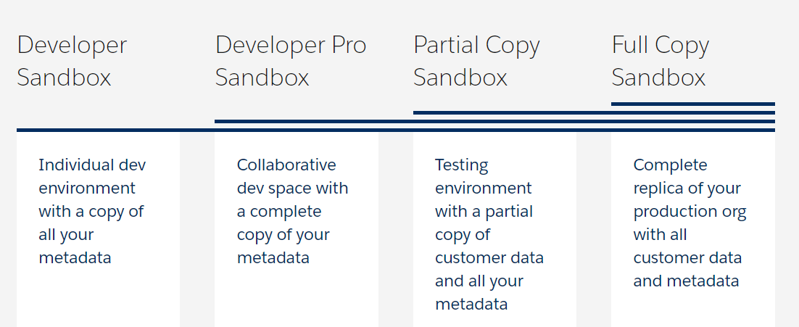
Sandbox

Slide 6
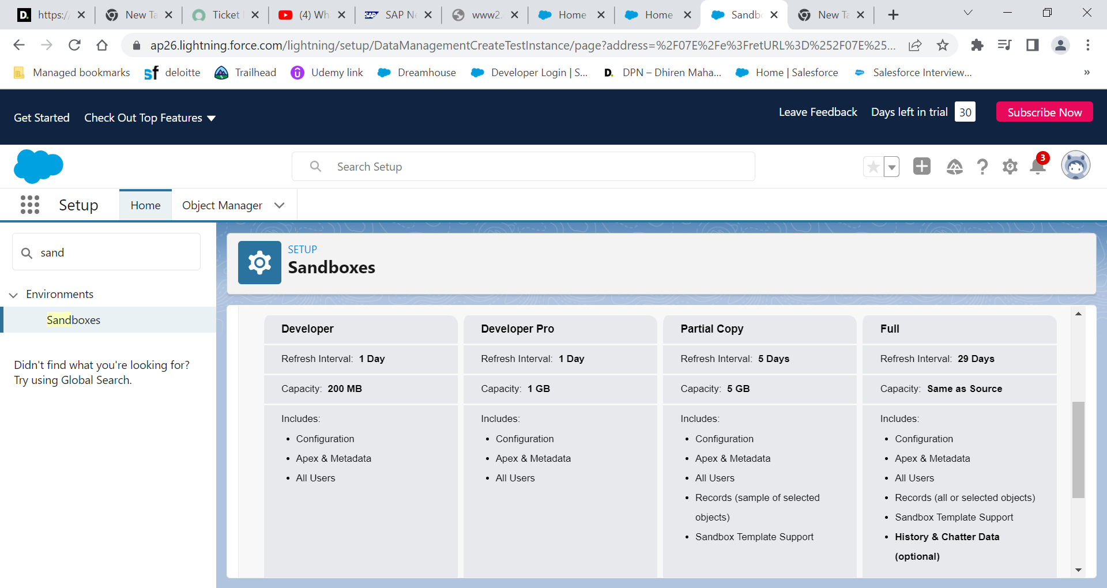

Slide 7
Sandbox Types:
Developer Sandbox
Included with most Salesforce licenses
Can be refreshed once per day
File storage limit of 200mb each
Developer Pro Sandbox
Have slightly higher storage limits
Can be refreshed once per day
included with Unlimited & Performance editions of Salesforce, but can be purchased separately

Slide 8
Sandbox Types (continued..) :
3. Partial Copy Sandbox
Allows you to not only copy metadata, but also a portion of your data
Used to test new functionality on live data, or if you wish to train users using live data, in a test environment
included with Enterprise, Unlimited & Performance edition Salesforce licenses, and can be purchased separately
Has a refresh interval of 5 days
Allows data storage up to 5GB
4. Full Sandbox
Full copy sandbox copies all your production metadata and data
Gives you an exact replica of your production Org in order to fully test functionality, as well as train new users
have a 29 days refresh interval
included with Unlimited & Performance editions of Salesforce, but can be purchased separately

Slide 9
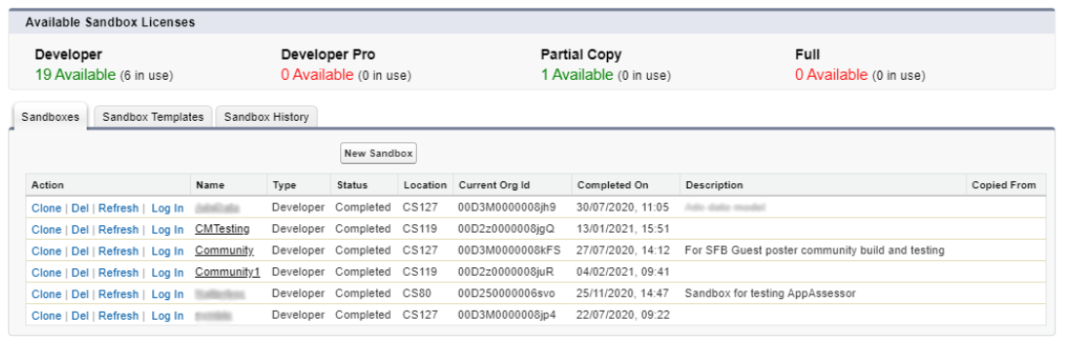
How to use salesforce Sandboxes ?
Can easily be created from Setup => Sandboxes (from Production Environment)
Below is how you may use the sandboxes used and availability:
Notes:
Example objectives
At the end of this lesson, you will be able to:
Save files to the team Web server.
Move files to different locations on the team Web server.
Share files on the team Web server.

Slide 10
Salesforce Instances
Sandbox
Production
Every salesforce org is hosted under a salesforce instance
Setup -> Company Information
Salesforce manages release and updates instance wise
Check the status of your instance and know about downtime or any maintenance from https://trust.salesforce.com/en/
Instance 1
Instance 2
Instance 3
Instance 4
Org 1
Org 4
Org 7
Org 10
Org 2
Org 5
Org 8
Org 11
Org 3
Org 6
Org 9
Org 12

Slide 11
Deployment Methods in Salesforce
Workbench
Change Sets
Force.com Migration Tool – ANT/Java based
VS Code

Slide 12
Workbench Deployment
Deployment via https://workbench.developerforce.com
Navigate to Migration tab:
Retrieve : upload package xml file to retrieve those components from salesforce org
Deploy : Upload zip folder containing metadata and package file to deploy into salesforce org
Sample package.manifest files can be found at : https://developer.salesforce.com/docs/atlas.en-us.api_meta.meta/api_meta/manifest_samples.html

Slide 13
Destructive Changes Deployment
Changes that requires deletion of metadata from Salesforce org
Sample package.manifest files can be found at : https://developer.salesforce.com/docs/atlas.en-us.api_meta.meta/api_meta/meta_deploy_deleting_files.html
destructiveChangesPre.xml : To delete components before adding or updating other components, create a manifest file that’s named destructiveChangesPre.xml and include the components to delete
destructiveChangesPost.xml : To delete components after adding or updating other components, create a manifest file that’s named destructiveChangesPost.xml and include the components to delete

Slide 14
Change Set Deployment
Navigate to Setup -> Environments -> Change Sets
Outbound Change Sets : Make changes in the organization you are logged into, and upload those changes to another organization
Inbound Change Sets : Accept, modify, or reject change sets uploaded from other organizations

Slide 15
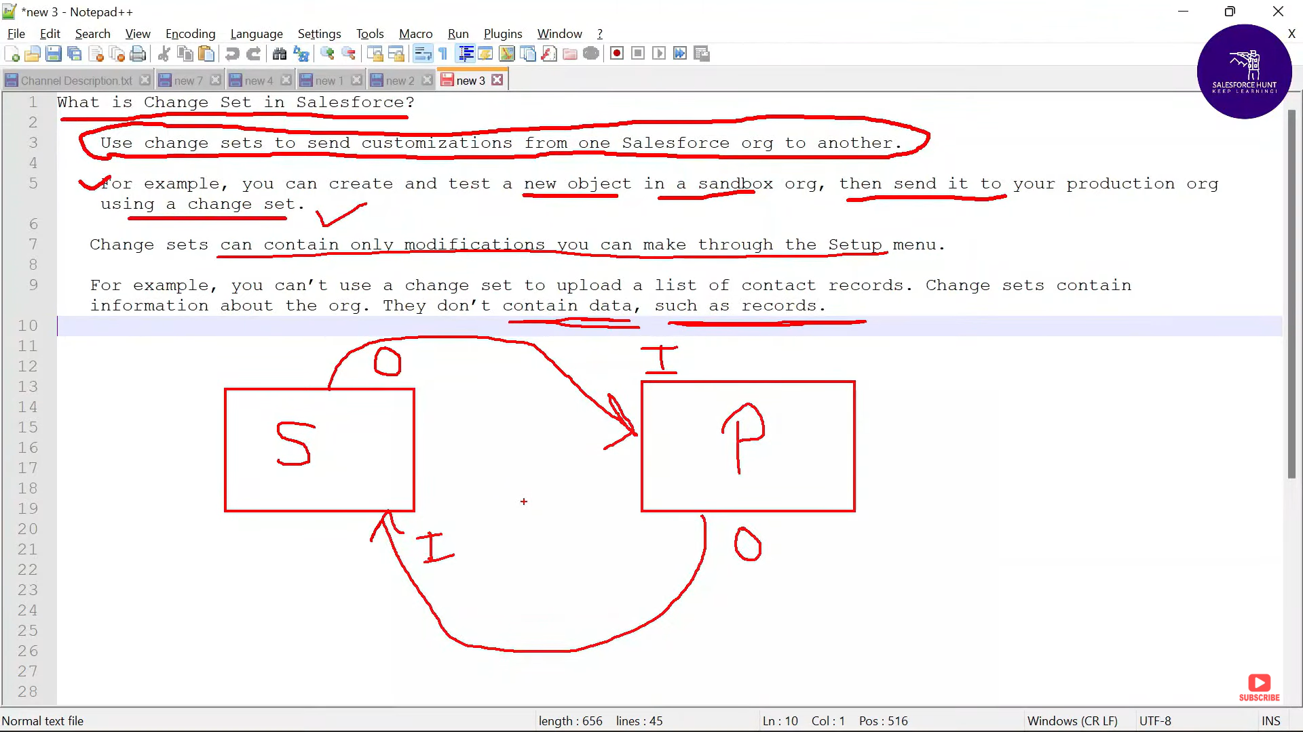

Slide 16
Ant Deployment
The Ant Migration Tool is a Java/Ant-based command-line utility for moving metadata between a local directory and a Salesforce Org.
For installing ANT: you may refer to -> https://developer.salesforce.com/docs/atlas.en-us.apexcode.meta/apexcode/apex_deploying_ant.html
Utilises command prompt to run commands for deployment purpose

Slide 17
VS Code Deployment
Install Salesforce CLI : https://developer.salesforce.com/tools/sfdxcli
Install VS Code and then from extensions : install “Salesforce extension pack”
Press “ctrl+shift+p” and use sfdx commands to create project & authorize an org
Modify package.xml file from manifest and deploy/retrieve the folders

Slide 18
Thank you !!
For any queries, please reach out to :
Siddharth Singh
Consultant | DCM : Digital Customer
Mobile: +91 9711950824
Email : siddharsingh@deloitte.com

